Slide 1
Review
G. White

Slide 2
Weight and Balance
CG is the Same as Total Moment Arm? T/F
If the Moment is 18,000 in-lbs and the Total Weight is 1,800 lbs, and the CG is 10 in. You Add 200 # of Baggage in Station that has a Moment Arm of -3; What is New CG?
Range is Time You Can Fly? T/F
Engine Oil is Included in Basic Empty Weight? T/F

Slide 3
Weight and Balance (cont.)
CG means? ______________
Max Gross Weight is Defined in POH as 3,000 lb, You Have Loaded the Plane to 3003 lbs; Is it Legal to Fly This Airplane? Y/N
  If Y, What is Your Rationale? _______
CG is Normally Aft of the Center of Lift? T/F
As Fuel Burns the CG Normally Shifts Aft? T/F
If an Airplane has an Aft CG it Will Be More Efficient T/F

Slide 4
Airplane Performance
Temp = 100 deg F, Pressure Altitude = 1,000’ – Density Altitude ___________
If Flying at 6,000’ Pressure Altitude, the OAT is -8 degrees and the CAS is 120 Knots, the KTAS is _____
Wind aloft: 3214+10; KCAS 100; Pressure Altitude 8,000; TH 190
  KTAS ____
  WCA ____
  GS _____
  CH _____

Slide 5
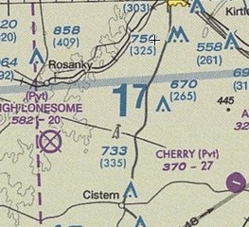
Use SAT Sectional
TC from Taylor (T74) to Caldwell (KRWV) ____
Distance ____ nm
MC ____
Airspace above T74 at 699’ AGL _____
Minimum Safe Altitude to Fly is 2,500’ T/F
This (17) is a MSA?

Slide 6
Flight Planning
You Plan to Fly Through the Brownwood 1 East MOA. To Obtain Updates on Activities You Would Contact FSS on 122.2 ? T/F
If You Fail to Close a Flight Plan, an Immediate Air Search and Rescue will be Initiated? T/F
You should Update Your Flight Plan with a New ETA if it Changes by More Than 30 Minutes. T/F

